Slide 1
Motivation

Slide 2
Motivation
Motivation: a need or desire that energizes and directs behavior.
Motivation (the organizational definition): forces within a person that affect direction, intensity, and persistence of voluntary behavior in the workplace.
Can reflect biological or psycho-social needs.
Biological: thirst, hunger, sleep, etc.
Psycho-social: achievement, acceptance, self-esteem, etc.

Slide 3
Intrinsic & Extrinsic Motivation
Intrinsic motivation: internal drive to perform task for its own sake.
More open to demands of the task and willing to learn.
Enjoyment serves as the reward or reinforcer.
Extrinsic motivation: external rewards reinforce the behavior.
Can produce good short-term outcomes.
Less effective for complex tasks or tasks requiring creativity.
More effective if used to boost feelings of competence rather than as a bribe.
Intrinsic vs. extrinsic motivation
No situation completely lacks external inducements (e.g. situational factors, psychological factors).

Slide 4
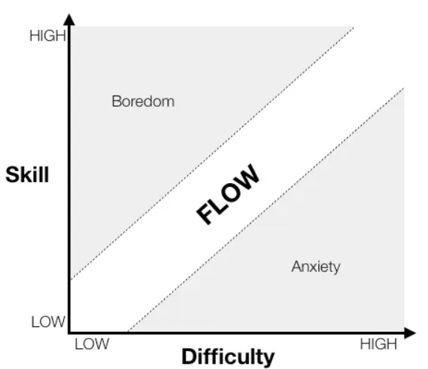
Cognitive Flow
Cognitive flow
A completely involved and focused state of consciousness, with diminished awareness of self and time, resulting from optimal engagement of one’s skills.
Incorporates elements of goal-setting theory and feedback.

Slide 5

Drive Reduction Theory
Idea that a physiological need creates an aroused tension state (a drive) that motivates an organism to satisfy that need.
Goal is homeostasis: maintenance of a steady internal state.
Humans motivated to satiate needs and reduce drives that cause tension.

Slide 6
Optimal Arousal Theory
Seeks to explain actions/ behaviors that produce tension.
Organisms seek an optimum level of arousal (e.g. exploring, curiosity).
Lacking stimulation, humans are bored and seek to increase arousal.
Too much stimulation leads to stress, so seeking optimum level between too much stimulation and boredom.

Slide 7
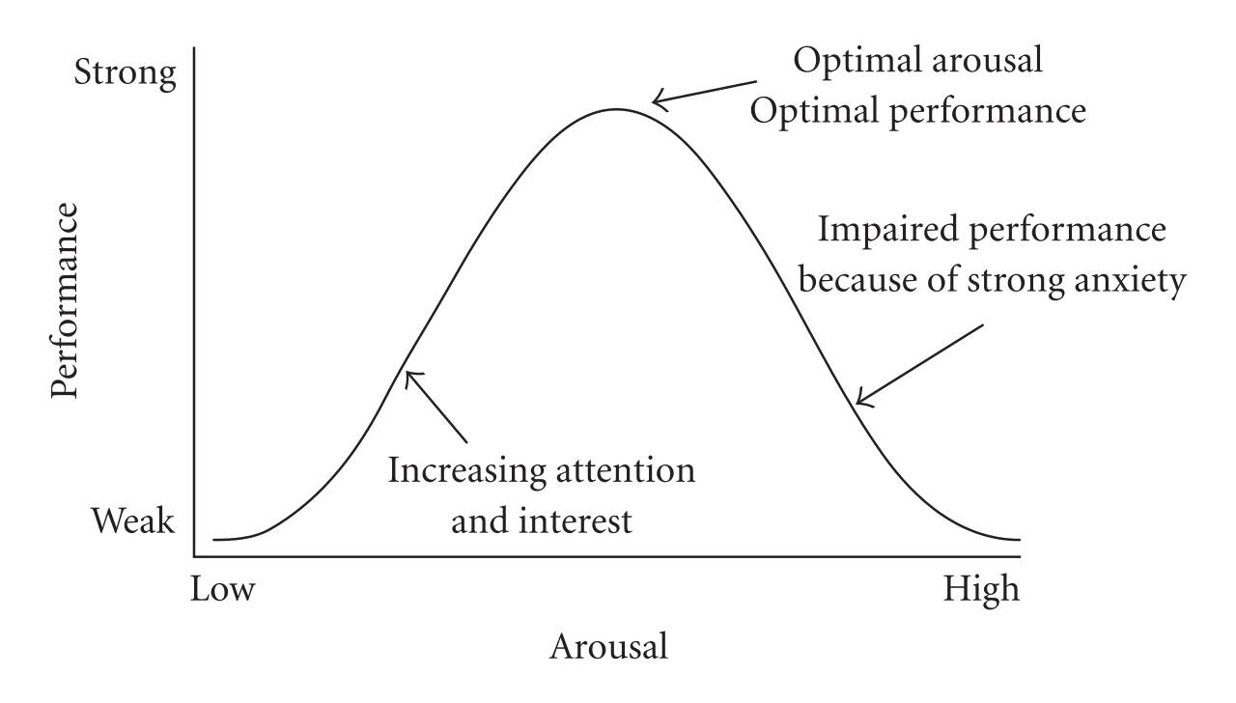
Yerkes-Dodson Law

Slide 8
Maslow’s Needs Hierarchy
Holistic
Integrative view of needs rather than studying each need in isolation.
Based on the premise that needs are the starting point of motivation.
Humanistic
Responses to higher needs are influenced by social dynamics, not just instinct.
Need gratification is just as important as need deprivation.

Slide 9
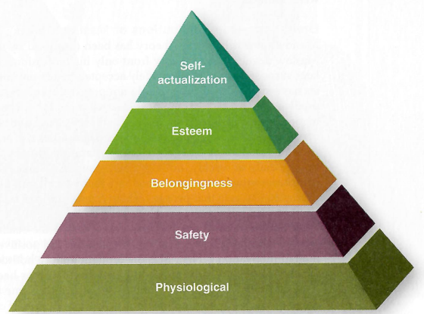
Maslow’s Hierarchy of Needs
Physiological
Food, water.
Safety
Need for secure and stable environment.
Absence of pain, threat, or illness.

Slide 10
Maslow’s Hierarchy of Needs
Belongingness
Need for love, affection, interaction with other people.
Esteem
Need for self-esteem through personal achievement.
Need for social esteem through recognition and respect from others.

Slide 11
Maslow’s Hierarchy of Needs
Self-actualization
Need for self-fulfillment.
Realization of one’s potential.
Striving for meaning and purpose.

Slide 12
Maslow’s Hierarchy of Needs
Deficiency needs: activated when unfulfilled.
Growth need: continues to develop even when fulfilled.
Self-actualization
Satisfaction progression hypothesis: as a need is satisfied, we move to the next level.

Slide 13
Maslow’s Hierarchy of Needs
Limitations:
Little empirical support.
Assumes needs priorities shift over a long time (years).
Needs priorities change with the situation (e.g. physiological needs are not always lowest in the hierarchy).
Can worry about different needs at the same time.
Values influence needs.
There might not be a universal needs hierarchy, varies depending on the person and the situation.

Slide 14
Learned Needs Theory (McClelland)
Based on idea that some needs can be learned.
Reinforcement, learning, and social conditions all impact need strength.
Identified three needs: achievement, affiliation, power.
Usually all are present but one is dominant.
Practical implication: offer employees a choice of rewards and a balanced environment.

Slide 15
Learned Needs Theory (McClelland)
Achievement: need in which people want to accomplish reasonably challenging goals and desire recognition for their success.
High need for achievement:
Prefers working alone.
Takes calculated risks to accomplish goals.
Desire unambiguous feedback and recognition for their success.
Desire significant accomplishment and mastering of skills.
Money is a weak motivator.
Entrepreneurs (high) vs. leaders (lower).

Slide 16
Learned Needs Theory (McClelland)
Affiliation: need in which people seek approval from others, conform to their wishes and expectations, and avoid conflict and confrontation.
Evolutionarily advantageous, health benefits.
High need for affiliation:
Tries to project favorable image of self to others.
Favors collaboration over competition.
Does not like high risk or uncertainty.
Less effective at making decisions that could potentially generate conflict.
Executives (lower).

Slide 17
Learned Needs Theory (McClelland)
Power: need in which people want to control their environment, including people and resources, to benefit either themselves (personalized power) or others (socialized power).
Personalized power: used to advance personal interests, power as a status symbol.
Socialized power: power as a means to help others (altruism, social responsibility).
High need for power:
Wants to control and influence others.
Enjoys competition.
Enjoys status and recognition.

Slide 18
Class Activity
Learned Needs survey.

Slide 19
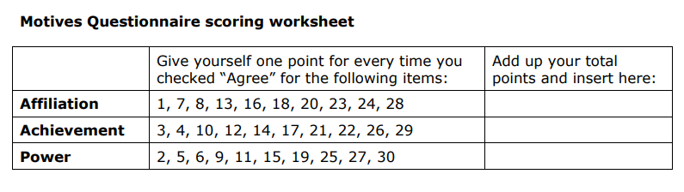
Learned Needs Survey

Slide 20
Learned Needs & Video Games
Achievement
Gear, titles, weapons
Affiliation
Social interaction, community
Power
Opportunities to get stronger, control resources, control other players/ characters

Slide 21
Class Activity
Needs Priority survey.

Slide 22
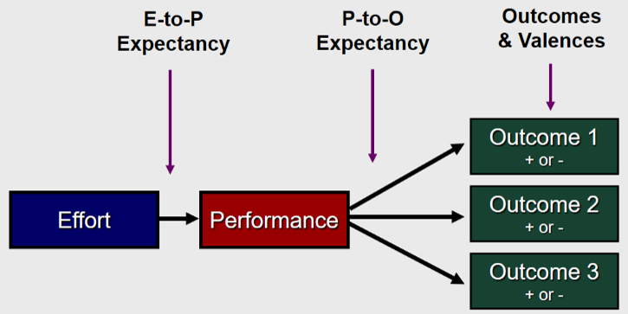
Expectancy Theory
Explains how internal factors translate into specific effort and behaviors.
Premise: we are motivated to achieve goals with the highest expected payoff.
If any of these components is weakened, motivation is weakened.

Slide 23
E-to-P Expectancy
Effort → Performance expectancy
Individual’s perception that effort will result in a particular performance level.
Increasing E-to-P expectancy
Select people with required competencies.
Train employees.
Provide role clarification and gradual progression.
Provide sufficient time and resources.
Provide coaching and feedback (increases confidence, gives direction, positive reinforcement).

Slide 24
P-to-O Expectancy
Performance → Outcome expectancy
Perceived probability that a specific behavior or performance level will lead to specific outcomes.
Increasing P-to-O expectancy
Measure performance accurately.
Clearly explaining outcomes that result from high performance (e.g. provide examples of other employees).
Explain how rewards are linked to performance (transparency in how performance is evaluated, who is being rewarded, what did they accomplish, etc.).

Slide 25
Outcome Valence
Outcome valence
Anticipated satisfaction/ dissatisfaction toward an outcome.
Range of negative to positive feelings about the outcome, influenced by personal values, needs, etc.
Increasing outcome valences
Ensure that rewards are valued.
Minimize counter-valent outcomes.
The Annual Dundies! - The Office US - YouTube

Slide 26
Expectancy Theory
Contributions:
Empirical support.
Provides clear guidelines for increasing motivation.
Predicts work effort well.
True across cultures.
Limitations:
Does not account for the role of emotions in effort and behavior.

Slide 27
Expectancy Theory as Framework for Game Design
Assuming it’s an issue of motivation.
E-P Expectancy
Are demands of task appropriate for the player’s ability?
Gradual progression of task difficulty?
Training or tutorials?
Sufficient time, resources, feedback for the players?
P-O Expectancy
Is there a clear link between performance and the reward?
Outcome Valence
What does your player value? Know your audience.
Different people have different needs and value different things.

Slide 28
Feedback Activity
In groups of 2 or 3.

Slide 29
Feedback
Constructive feedback: when feedback offers concrete information that can be used.
Destructive feedback: general comments about performance, inconsiderate tone, attribution of poor performance to internal factors.
Main functions of feedback:
Motivational
Learning (corrective)

Slide 30
Feedback Sources
Non-social feedback sources: feedback an employee receives directly from the job/ task.
Non-social feedback:
Preferred for gauging work progress.
Considered more accurate since it’s directly from the job.
Social feedback:
Well-received for “good news” feedback.
Improves self-image and esteem.

Slide 31
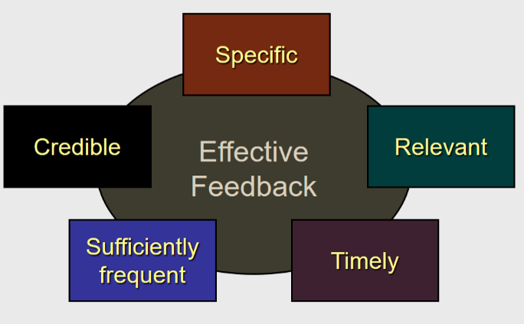
Characteristics of Effective Feedback
Feedback motivates when it is:
Constructive
When employees have strong self-efficacy.
Self efficacy: one’s belief in their capacity to execute behaviors necessary to produce specific performance outcomes.

Slide 32
Feedback in Video Games
Sufficiently frequent?
When and how often to give feedback (early vs. late in game)?
How much feedback to give at a time (memory)?
Is feedback motivational? Corrective?
How to give the feedback (format)?
Specific?
Pilot testing/ focus groups to ensure that you are clear.
Timely
If a player makes a mistake, when do they find out?

Slide 33
Feedback
Limitation of feedback:
People prefer to give positive feedback rather than negative feedback.
People more willing to give feedback when:
Results are positive.
Source and recipient get along well.
Organizations should make sure:
Information is perceived to be important and tied to rewards.
There are positive norms in the organization for giving feedback.

Slide 34
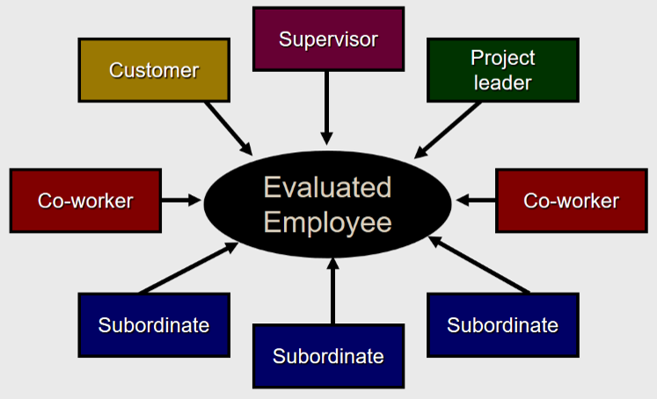
360˚ Feedback
More complete picture.
Can include self evaluations.
Limitations:
Could have conflicting results.

Slide 35
Goal Setting Theory
Goals: objectives that employees try to accomplish from their work effort.
Improves motivation.
Goal setting: process of motivating employees and clarifying their role perceptions by establishing performance objectives.
Goal setting theory improves performance by:
Amplifying intensity, persistence, and direction of effort.
Breaking a goal down into component parts.
Allowing us to assess how to accomplish the goal via specific behaviors.

Slide 36
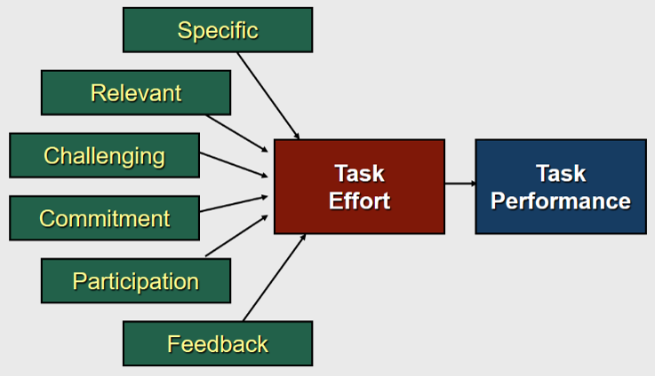
Goal Setting Theory

Slide 37
Goal Setting Theory
Specific
“Do your best goal” vs. specific.
Break a goal down into its component parts.
Identifies actions and behaviors for goal attainment.
Relevant
Relevant to the task.
Within your control.
Challenging
Stretch goals vs. easy goals.

Slide 38
Goal Setting Theory
Commitment
Realistic (not impossible).
Publicly committing to the goal.
Participation
Higher commitment to goal.
Improved goal quality.
Caveat: depends on the situation/ individual.
Feedback
Provides information on whether effort is properly directed.
Provides information on whether goal was achieved.

Slide 39
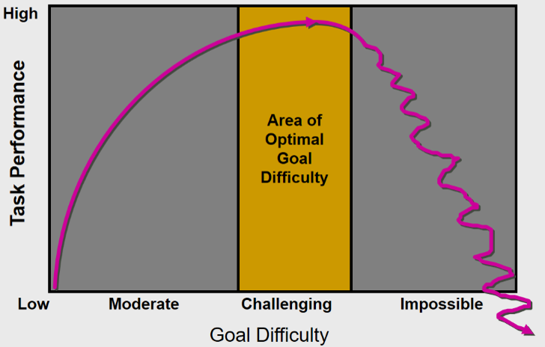
Goal Setting Theory

Slide 40
Goal Setting & Feedback
Tried-and-true theories in organizational behavior.
Valid
Practical utility
Empirical support
Improves motivation and performance.
Limitation:
Focuses on observable indicators that can be measured.
Some valued aspects of performance are difficult to measure.
Goal-setting effective in established jobs but interferes with learning in new, complex jobs.

Slide 41
Goal Setting in Video Games
What goals are set for the players?
Are goals specific?
Are goals clearly articulated?
Are goals sufficiently challenging (stretch goals) but achievable?
Progression of goal difficulty?
Do players set their own goals?

